Slide 1
TigerCheck v2
Rebuilt by: Ethan Darby, Zachary White, Nick Bean, Ross Spears

Slide 2
Project Introduction
TigerCheck is a data collection collaboration between the College of Nursing and the college of Engineering.
The primary purpose of TigerCheck is to allow nurses to go to varied locations, gather health data from the people at said location, and store the data for future statistics
The overlying project for this program is Kidcheck, Alabama’s child health data aggregator

Slide 3
TigerCheck v1
Project has been running for at least 4 semesters
Poor design practices
Wordy, unnecessarily complex code
Working, but fairly unstable

Slide 4
TigerCheck v2
Reworking the design with emphasis on readability, and modularity
Redesigning the code to cut down on fluff
Designing a prototype to not mess with production code.

Slide 5
Requirements
A well Structured and Reliable database
Complete and concise documentation
A dynamic code base, absent of hard-coded solutions
A locally installed windows form instead of the previous website
The ability to export data as reports and raw data

Slide 6
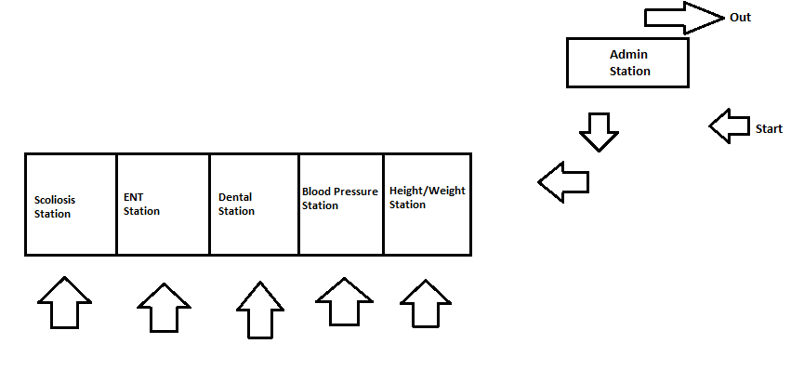
Sample day of TigerCheck

Slide 7
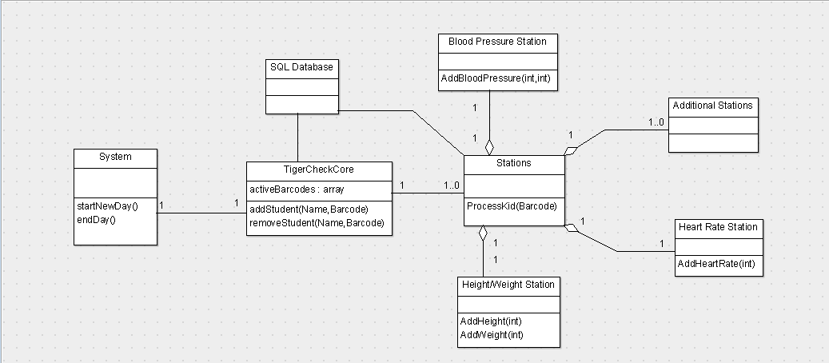
Design

Slide 8
Plan for Future Cycles
Station functionality
Update GUI
Be able to generate reports
Be able to export data
Add functionality to TigerCheck v1 asked for by the customer

